Slide 1
Are You Paying Attention?
The Cognitive Cost of
Speech Perception Adaptation
Rachel Sabatello

Slide 2

Introduction
Speech production is variable
Our ability to perceive speech is adaptable
A
B
C
D
E
F
ASHI
ASI
Notes:
Some people perceive these sounds like this

Slide 3
Introduction
Speech production is variable
Our ability to perceive speech is adaptable
ASHI
ASI
A
B
C
D
E
F
Notes:
Or like this

Slide 4
Introduction
Speech production is variable
Our ability to perceive speech is adaptable
Perception is guided by expectations from previous experiences.
ASHI
ASI
A
B
C
D
E
F
Notes:
Or like this
Next slide: How do we learn from previous experiences?

Slide 5
(2AFC) Lexical Decision Task
Hear a word or a nonword
Word
Nonword
Labeling
Notes:
One way we are able to learn how a talker produces sounds is by recognizing the sound in an identifiable word. When simulating this process in participants, we often use a 2-alternative forced choice decision task in the field.
When unambiguous context is given, the atypical production is labelled.
---
Example of an ambiguous lexical context: seat vs sheet

Slide 6

My graduation is a personal achievement
Is Talker A saying “Personal”?
Talker A
Listener
A
B
C
D
E
F
ASHI
ASI

Slide 7
My graduation is a personal achievement
Is Talker B saying “Graduation”?
Talker B
Listener
A
B
C
D
E
F
ASHI
ASI
Notes:
Next slide: How do we measure perception?

Slide 8
(2AFC) Categorization Task
Hear a sound
Ashi
Asi
0
1
Notes:
To use these responses as a form of measure, we assign the value of 1 to one of the responses (here ASHI), and 0 to the other.

Slide 9
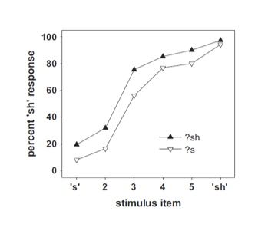

Measuring Perception
Proportion of ASHI responses
We measure perception by certainty
The consistency of the perceived sound category along a continuum (e.g., ASI-ASHI)
100%
Sh
Target the perceptual boundary
Where the proportion of responses is equal to chance (50%)
50%
100%
S
Train participants to recognize an ambiguous sound as one end of the spectrum shifts the perceptual boundary
Steps that transition ASI $→$ ASHI

Slide 10
Experimental Design
ASI
ASHI
S
Sh
?sh/?s
Continuum B
Continuum A
?s — Sh
S — ?sh
Notes:
In the experiment I am presenting today, we will simulate two distinct talkers on the s/sh continuum, with inversely atypical productions.

Slide 11
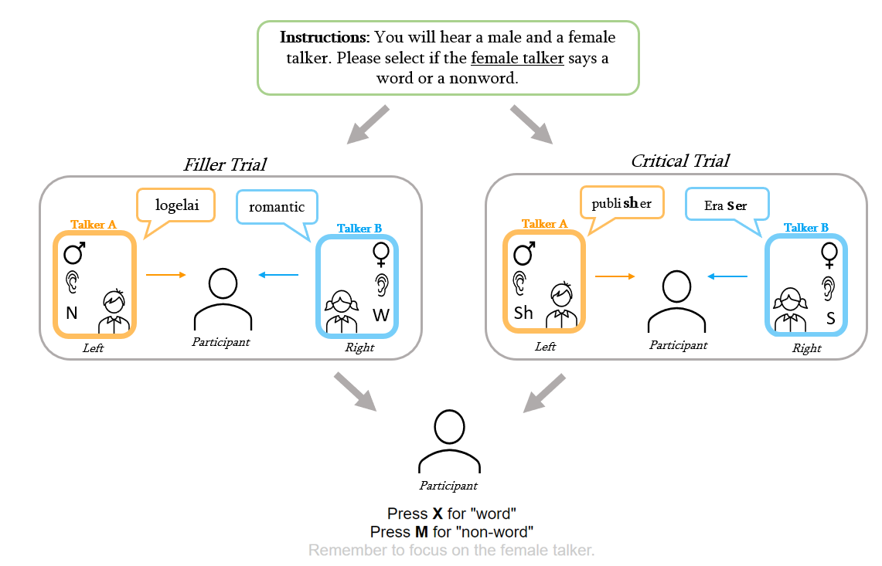
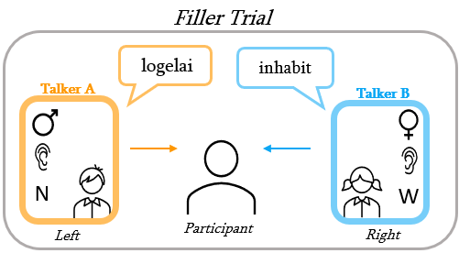
The Exposure Phase
Notes:
One talker will be presented in one ear of the listener, and will produce a sound in either a male or female presenting voice. The second talker will be presented in the other ear, and be produced in the opposite ear. Our goal is to simulate two distinct talkers in different spatial locations.
During filler trials, one talker will produce a word and the other talker will produce a nonword.
During the critical trials, both talkers will produce words that contain an s/sh sound.
The ear presentation of the speaker and if the speaker produced a real English word were balanced for the Attended Talker

Slide 12
Design
Practice Block
Exit Survey
Exposure Phase
Test Phase
Exposure Block
Both Talkers heard during trials
Contains 8 trials
2 Critical Items
6 Filler Items
Randomized within block
Test Block
1 Talker/block
Talker Alternates every 2 blocks
Contains 6 trials
The 6 unique Test Items
Notes:
4 practice filler trials where the participants were given feedback. They had to respond to all four trials correctly consecutively to progress to the Exposure Phase
The Exist survey consisted of some questions gauging the functionality of the experiment, feedback about what participant’s experienced, and some necessary demographic information.
25% of the trials in each exposure block are critical trials
- Of the 2 critical trials, 1 is a typical sounding s or sh, and the second is an atypical production of the alternative.

Slide 13
Participants
64 Participants were recruited for this experiment. A total of 4 were excluded for:
Self Report Following Directions
1 participant excluded for using external speakers
1 participant excluded for reporting they listened to the wrong talker
Lexical Decision Task Accuracy
2 participant excluded for answering more than 80% of the tasks incorrectly
0 participants excluded for answering more than 60% of the ambiguous critical items incorrectly
Lexical Decision Task Accuracy
2 participant excluded for answering more than 80% of the tasks incorrectly
0 participants excluded for answering more than 60% of the ambiguous critical items incorrectly
Notes:
Low exclusions: most performed the task correctly and were able to perform the lexical decision task accurately

Slide 14
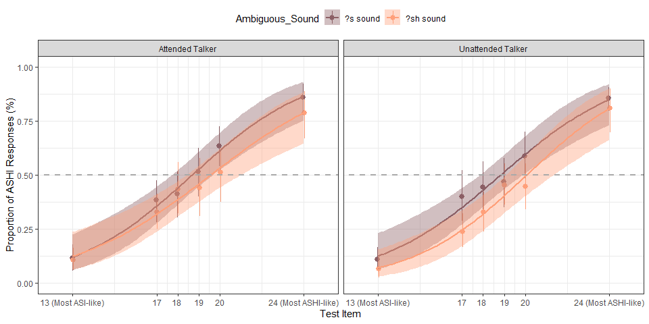
Figure 1a: No significantly different perception of either atypical sound
Notes:
The points represent the actual average proportion of ASHI trials for each Test Item, and the lines/shading represent a 95% confidence interval

Slide 15
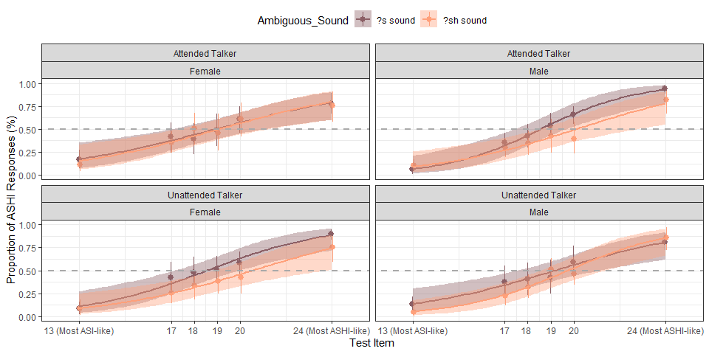
Figure 1a: No significantly different perception of either atypical sound
Notes:
Slight difference in the male attended talker and female unattended talker

Slide 16
Implications/Discussion
No adaptation to either the Attended Talker or the Unattended Talker
High accuracy on the lexical recognition task
Accuracy for at least 6 of the ambiguous critical
Low number of exclusions (93.75% of participants included)
No s/sh categorization prescreen?
Changes to test continuum?
Noise due to lack of SOA?
The task itself?
Notes:
Samuel 2016 screened participants for their ability to categorize the ASI/ASHI spectrum
The Samuel 2016 test continuum was found to be s-biased by later experiments, so we sampled different steps from the ASHI/ASI continuum while still using the original synthesized stimuli
Our Talkers started speaking at the same time. Prior studies implemented a stimulus onset asynchrony, having one talker begin speaking first. In these studies, adaptation was found. It may be possible that the overlapping from both talkers produced too much noise in the environment that when listeners perceived an atypical production, they processed it as due to noise and did not learn that the talker produced an unusual pronunciation, but recognized the word through top-down processing
A lexical recognition task encourages the listener to focus on if they had heard a word. Given the difficulty and the cognitive load of the task, it is possible that finer-grained speech cues were disregarded because they were less relevant to the task.

Slide 17





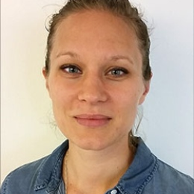
Thank You!
Dr. Chigusa Kurumada
Dr. Florian Jaeger
Dr. Daniel Murzek
Thesis Committee Member
PI & Thesis Advisor
Thesis Committee Member
Maryann Tan
Shawn Cummings
Anna Persson
HLP Lab Member
HLP Lab Member
HLP Lab Member
Notes:
Thank the Weisman fellowship, the department, and the U of R for the opportunity and experience

Slide 18
Thank You!

Slide 19
Talker A & B: Critical Items
Ambiguous
Assignment
Gender
Ear
Talker A
?s
Male
Left
Talker B
?sh
Female
Right

Slide 20
Talker A & B: Filler Items
Sound
Gender
Ear
Talker A
Word
Male
Left
Talker B
Nonword
Female
Right

Slide 21
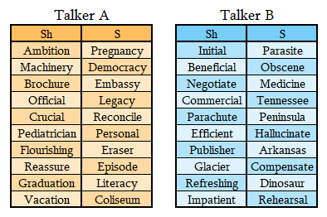
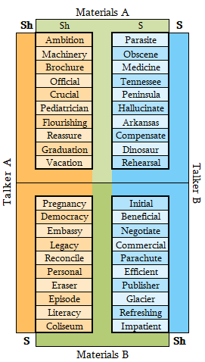
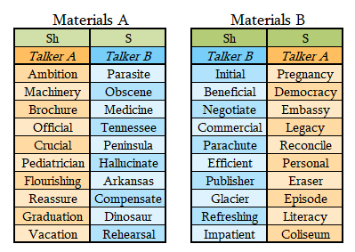

Slide 22
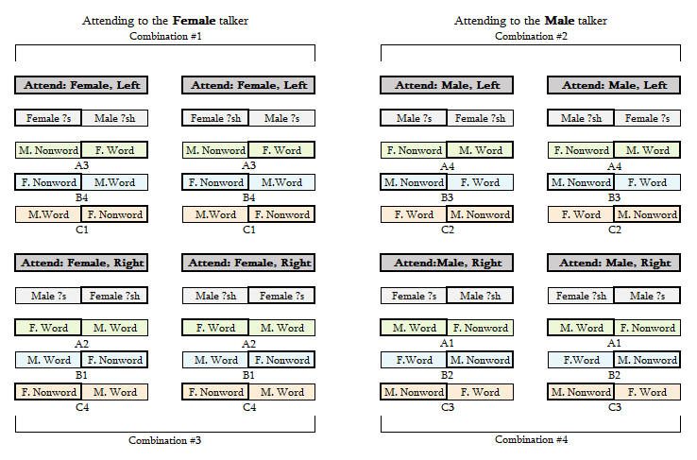
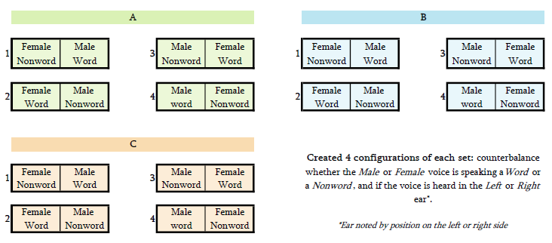

Slide 23
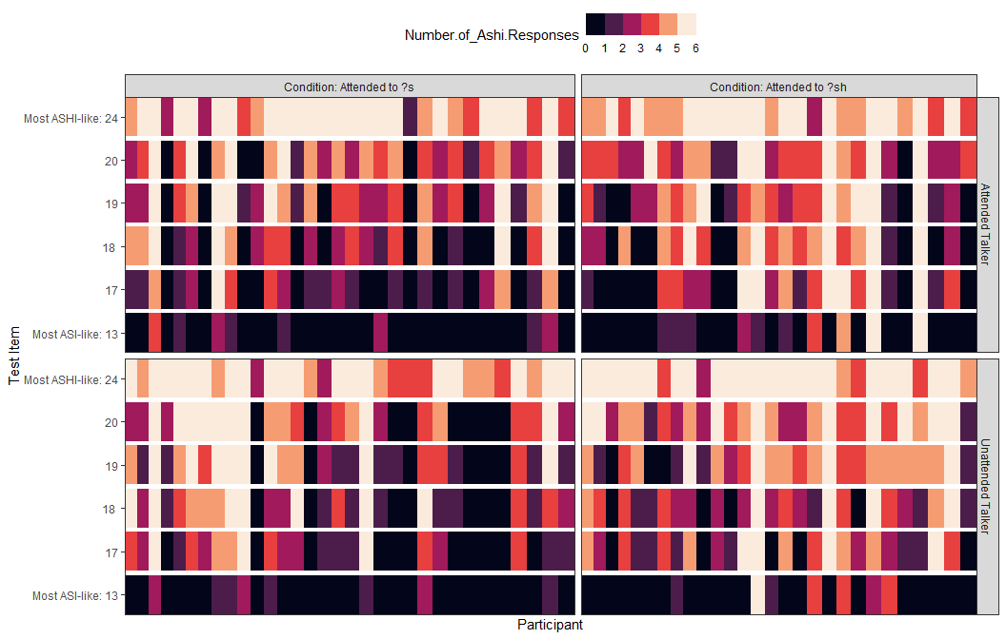
Figure 4: Number of ASHI Responses per subject by token

Slide 24
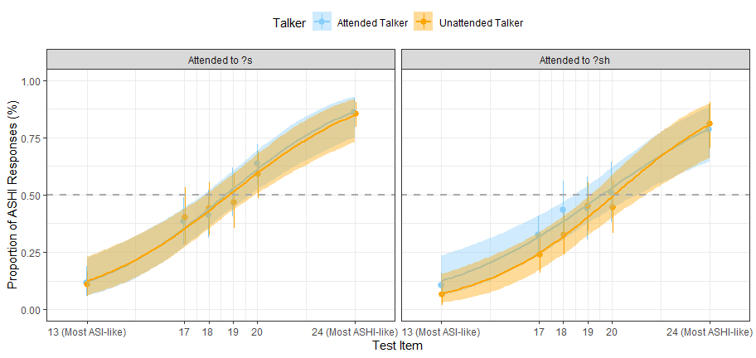
Figure 2: No difference in perceiving the Attended and Unattended Talkers

Slide 25
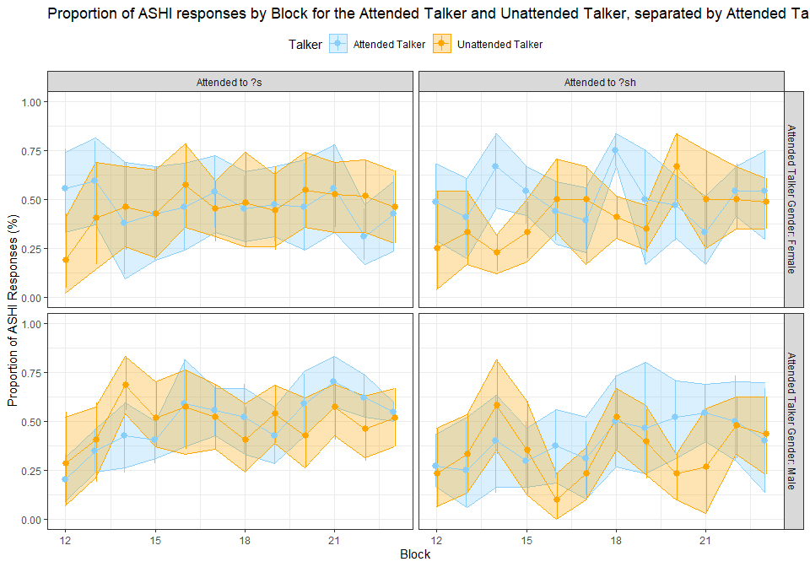
Figure 3: Proportion of ASHI responses by block

Slide 26
